Slide 1
RATIO
SIMPLYFING RATIO
SHARING IN RATIO
RATIO AND DIRECT PROPORTION

Slide 2
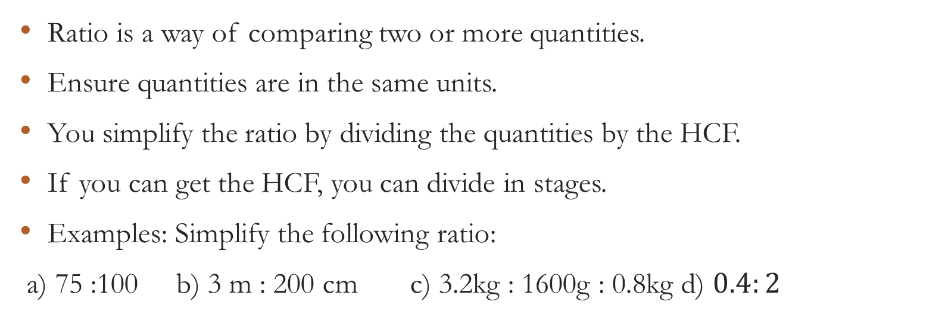
SIMPLYING RATIO
Ratio is a way of comparing two or more quantities.
Ensure quantities are in the same units.
You simplify the ratio by dividing the quantities by the HCF.
If you can get the HCF, you can divide in stages.
Examples: Simplify the following ratio:
a) 75 :100 b) 3 m : 200 cm c) 3.2kg : 1600g : 0.8kg d) $0.4:2$

Slide 3
SHARING IN RATIO
Example:
Dave, Ella and Jia share their electricity bills in the ratio 3:4:5. How much does each of them pay when their electricity bill is $168?

Slide 4
Ratio and Direct Proportion
Ratio can be used for comparison.
A tin of biscuits contains coconut and ginger biscuits in the ratio 3:7. The tin contains 50 biscuits. a) What fraction of the biscuits in the tin are coconut biscuits? b) How many coconut biscuits are in the tin?
NOTE: Explain how to get fraction from this kind of question.

Slide 5
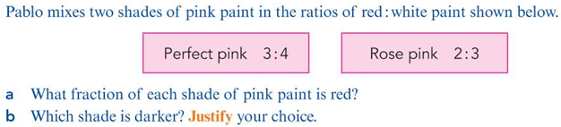
Example

Slide 6
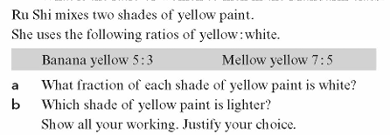

Activities
Simplify: a) $2.5:5$ b) 1 minute : 42 seconds

Slide 7
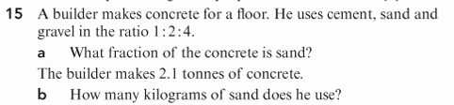
ASSIGNMENT
Cambridge Lower Secondary Mathematics Workbook 8,pg 158, Ex.12.3, No 15

